Slide 1

Overview for the New Jersey Quality Single Accountability Continuum (NJQSAC) User Manual
Division of Field Support and Services​
County Offices of Education​
July 2025​

Slide 2
NJQSAC: Background
In evaluating the performance of school districts, the NJDOE is guided by the “District Performance Review” (DPR), which consists of quality performance indicators (indicators) in each of the five key components of school district effectiveness, listed below:
  Instruction & Program
  Fiscal Management
  Governance
  Operations
  Personnel
The indicators are the specific, objective criteria by which each school district’s performance, capacity and need for State support, assistance or intervention are measured.

Slide 3
NJQSAC Process
The NJQSAC evaluation process is initiated by the county office of education providing training and orientation for districts being monitored that school year.
Each school district submits a self-evaluation using the DPR.
  In the self-evaluation, the school districts score themselves on each indicator in the five areas in the DPR (Instruction & Program; Fiscal Management; Governance; Operations; Personnel).
The County Offices, led by the Executive County Superintendents (ECS), conduct a verification process by reviewing the documentation that the school district provided in support of their scores for each indicator.
  The verification process is remote, unless stated.
  If there are questions, clarifications or additional information is needed, a site visit may be scheduled at the discretion of the ECS.
After the verification process the county office will issue a score for all DPR areas.
  If the district score is below 80% in an area, they must develop a District Improvement Plan in accordance with N.J.A.C. 6A:30-5.4.

Slide 4
NJQSAC User Manual: Goal and Purpose
Three goals of the NJQSAC User Manual
1. Improve Consistency:
    The User Manual improves the consistency of the NJDOE’s monitoring throughout the State.
2. Increase Transparency:
    The User Manual provides transparency of the NJDOE’s accountability measures.
3. Provide Clarity:
    The User Manual clarifies the content of the DPR and what is expected of school districts.

Slide 5
NJQSAC User Manual: General Content
The manual contains the following sections:
  Introduction: The introduction outlines the background and purpose of NJQSAC and the Manual
  The NJQSAC process and applicable mandates, statues, and regulations
  An overview for each area of the DPR (Instruction & Program; Fiscal Management; Governance; Operations; Personnel)
  Resources for four areas of the DPR (Instruction & Program; Fiscal Management; Operations; Personnel).
  The NJQSAC District Improvement Plan (DIP) process
  NJQSAC Academic Progress Score Conversion Chart
  Glossary of Terms: There is a glossary of terms used throughout the Manual, which includes citations regarding where the definitions can be found.

Slide 6
NJQSAC User Manual: Content of DPR Sections
The five NJQSAC DPR area’s overview provides each indicator that is broken down into the following subsections:
  The Indicator: The full text of each indicator is listed, along with the total number of points available for the indicator.
  Purpose: Following each indicator, the purpose of the indicator is explained.
  Documentation for Verification: This subsection is a bulleted list of the documentation used to demonstrate the school district’s compliance with the indicator.
  Department Review Process: This subsection provides step-by-step directions regarding how the county offices will review the documentation submitted by the school districts.
  Verification of Indicator Compliance: This subsection summarizes the criteria used by the County Offices in awarding points for the indicators.

Slide 7
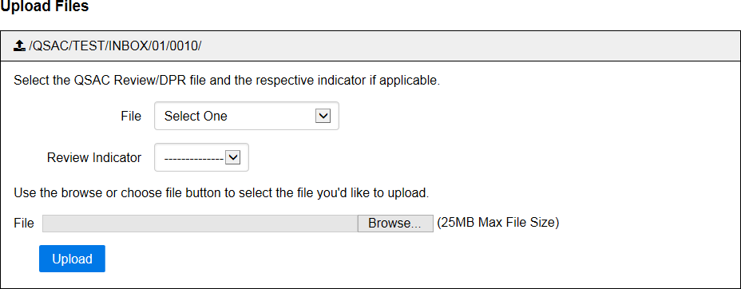
Uploading Documentation in Homeroom
School districts upload the DPR documents, and all documentation used for verification of compliance in Homeroom.

Slide 8
NJQSAC Scoring
Instruction and Program
  The first seven indicators will be scored by the Department.
  Point values vary by a school district’s grade configuration.
  Indicators 8 and 19 have a five-point value.
  Curriculum alignment indicators 9 through 18 have a 3-point value.
Fiscal, Governance, and Operations
  No varying point values; each indicator has the same point value regardless of a school district’s grade configuration.
Personnel
  Indicators 1a through 1c point value vary depending on meeting the indicator requirements.

Slide 9
Instruction and Program Grade Configuration Scoring
The school district is comprised of any composition of: | K – 8 | K – 12 | 9 – 12
1. The school district’s ELA achievement score. The score is comprised of the following: Overall performance: The proficiency rate of all students in a school district; Student group performance: The proficiency rate of all student groups; | 10 | 7 | 10
2. The school district’s mathematics achievement score. The score is comprised of the following: Overall performance: The proficiency rate of all students in a school district; Student group performance: The proficiency rate of all student groups. | 10 | 7 | 10
3. The school district’s science achievement score: The score is comprised of the following: Overall performance: The proficiency rate of all students in a school district; Student group performance: The proficiency rate of all student groups. | 5 | 3.5 | 5
4. The school district’s ELA academic progress. Academic progress is calculated to include student group performance by averaging the mSGP of all students with the average of all student groups’ mSGPs. | 12.5 | 8.75 | 0
5. The school district’s mathematics academic progress. Academic progress is calculated to include subgroup performance by averaging the mSGP of all students with the average of all student groups’ mSGPs. | 12.5 | 8.75 | 0
6. The school district’s graduation rate (average of four-year and five-year adjusted cohort graduation rates). Graduation rate is calculated to include subgroup performance by averaging the combined graduation rate (i.e. the average of the four-year and five-year graduation rates) of all students with the average of all student groups’ combined graduation rates. | 0 | 15 | 25
7. The school district’s measures for school quality and student success are calculated to account for student group performance by averaging the rates for all students with the average of all student groups’ rates. | 10 | 10 | 10

Slide 10
Next Steps
Review Indicators and Manual
Bring your District NJQSAC team together to start planning
Contact your county office with questions or contact qsac@doe.nj.gov
NJQSAC monitoring

Slide 11






Thank You!
New Jersey Department of Education
@NewJerseyDOE
New Jersey Department of Education: nj.gov/education
New Jersey Department of Education
@newjerseydoe
New Jersey Department of Education
@newjerseydoe

